Slide 1
Meeting 22/04/22

Slide 2
Outline
LSTM model
PR input sequence
PR output sequence
CNN LSTM hybrid model
Image input sequence
PR output sequence

Slide 3
LSTM PR sequence

Slide 4
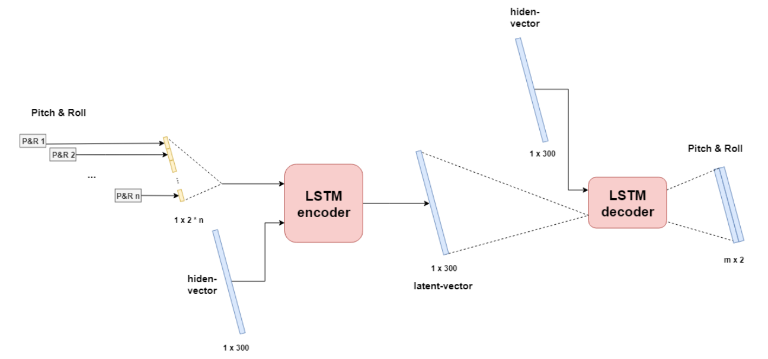
LSTM PR sequence
Encoder decoder LSTM network
Architecture:
LSTM encoder:
Processes input sequence
Hidden size = 300
LSTM decoder:
Processes output from encoder
Hidden size = 300
Outputs PR sequence

Slide 5
Training
Train, test, validation: 80, 10, 10
Trained for 50 epochs
Batch size 64
Learning rate of 0,001
I/O-sequence (2fps)
60/60 frames
10/60 frames

Slide 6
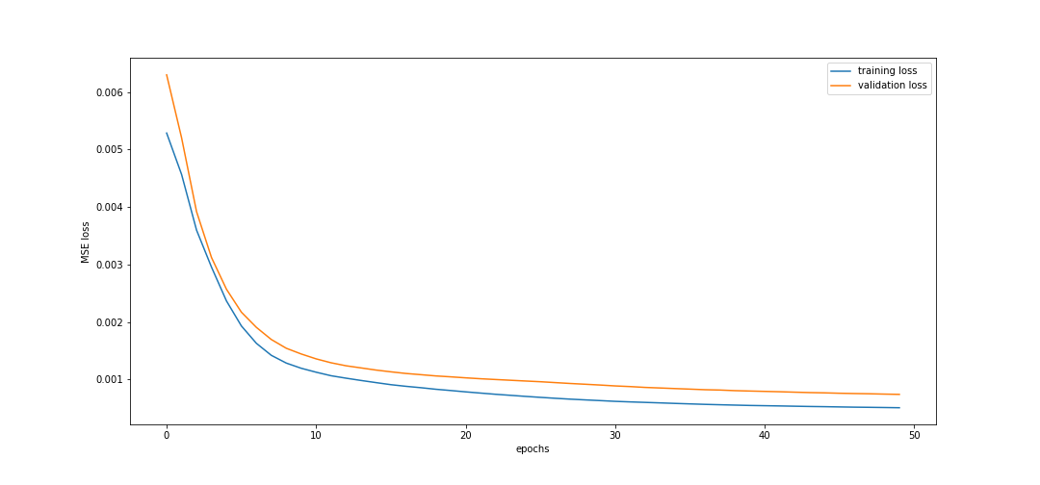
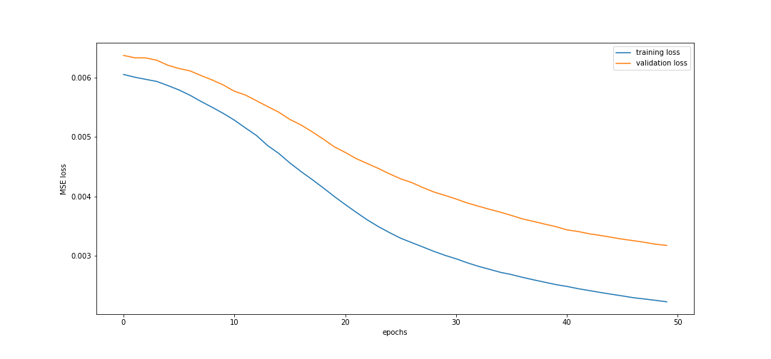
Training results
60/60 (top)
Good convergence
10/60 (bottom)
Poor convergence

Slide 7
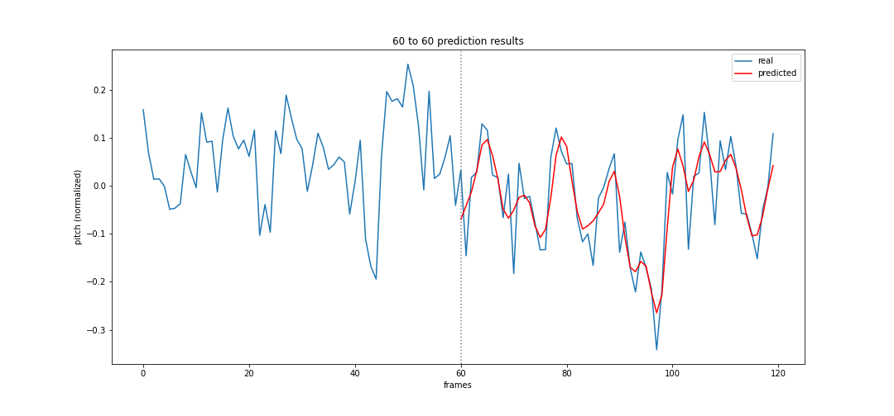
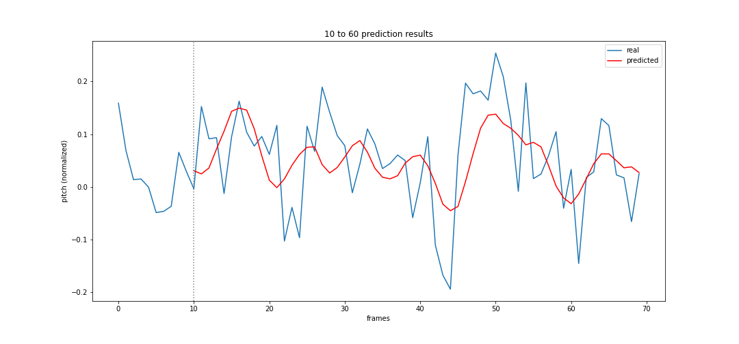
Prediction results: Pitch
60/60 (top)
Good convergence
10/60 (bottom)
Poor convergence

Slide 8
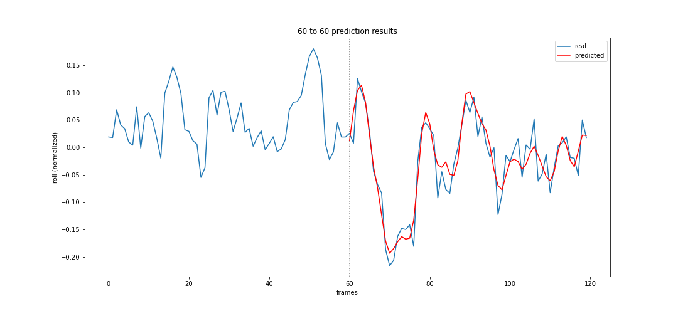
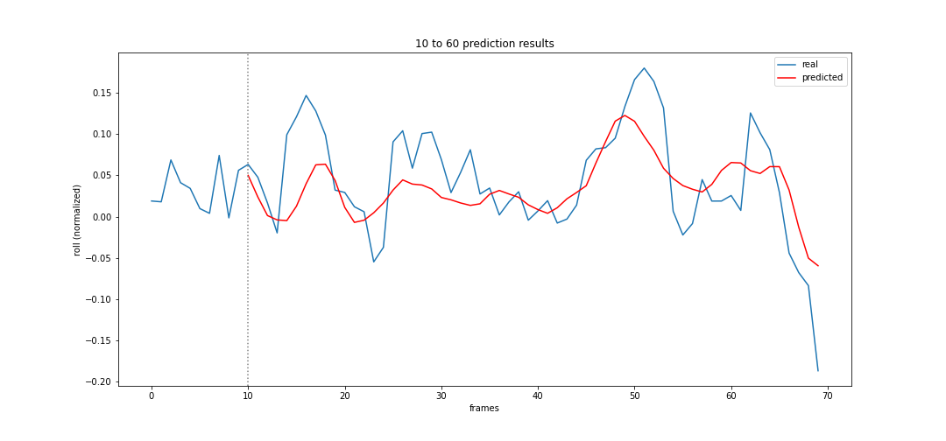
Prediction results: Roll
60/60 (top)
Good convergence
10/60 (bottom)
Poor convergence

Slide 9
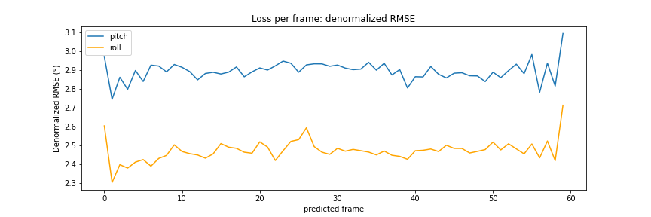
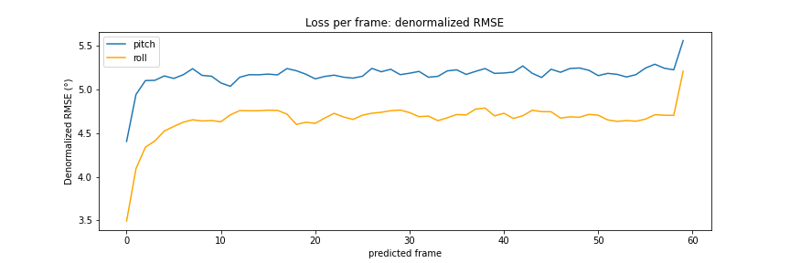
Loss per frame
60/60 (top)
Good convergence
LPF < 3,1°
10/60 (bottom)
Poor convergence
LPF < 5,5°

Slide 10
LSTM results
MODEL | Avg. PITCH error (°) | Avg. ROLL error (°)
60/60 LSTM | 2.23° | 1.96°
60/60 Zero | 6.44° | 7.27°
10/60 LSTM | 5.18° | 4.66°
10/60 Zero | 6.33° | 7.43°

Slide 11
CNN LSTM

Slide 12
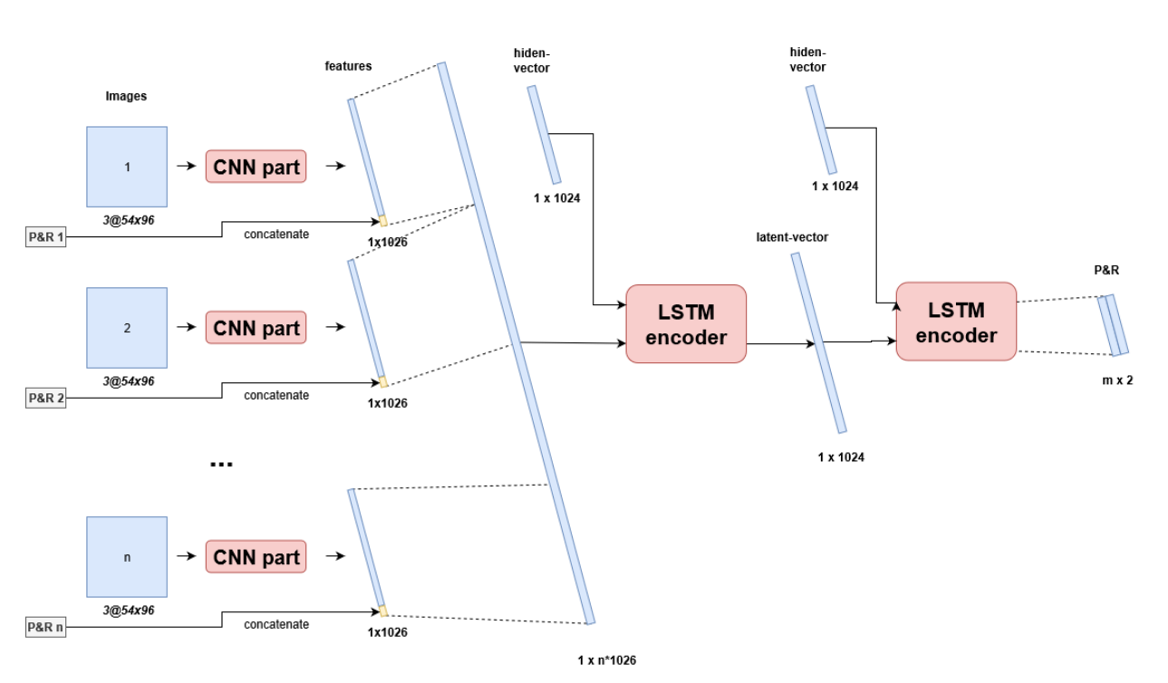
LSTM PR sequence
CNN Encoder decoder LSTM network
Architecture:
CNN feature extraction
LSTM encoder:
Processes feature vector
Hidden size = 1024
LSTM decoder:
Processes output from encoder
Hidden size = 1024
Outputs PR sequence

Slide 13
Training
Train, test, validation: 80, 10, 10
Trained for 50 epochs
Batch size 64
Learning rate of 0,001
I/O-sequence (2fps)
10/60 frames

Slide 14
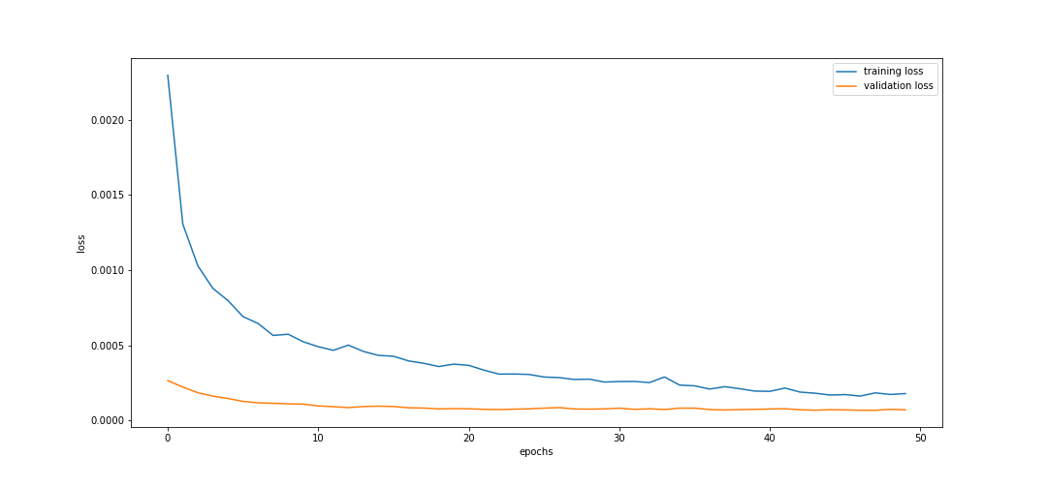
Training results
10/60 (top)
Good convergence
Low validation loss

Slide 15
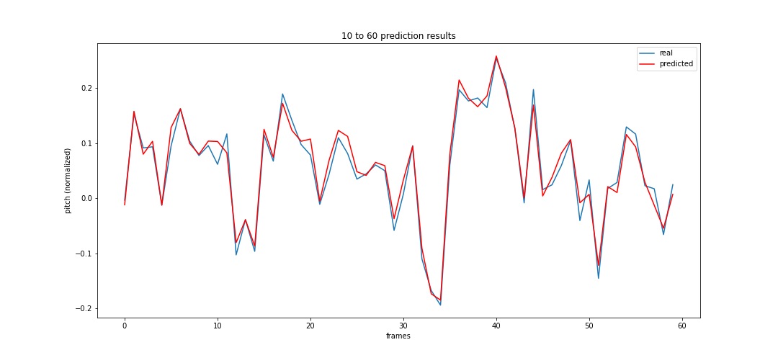
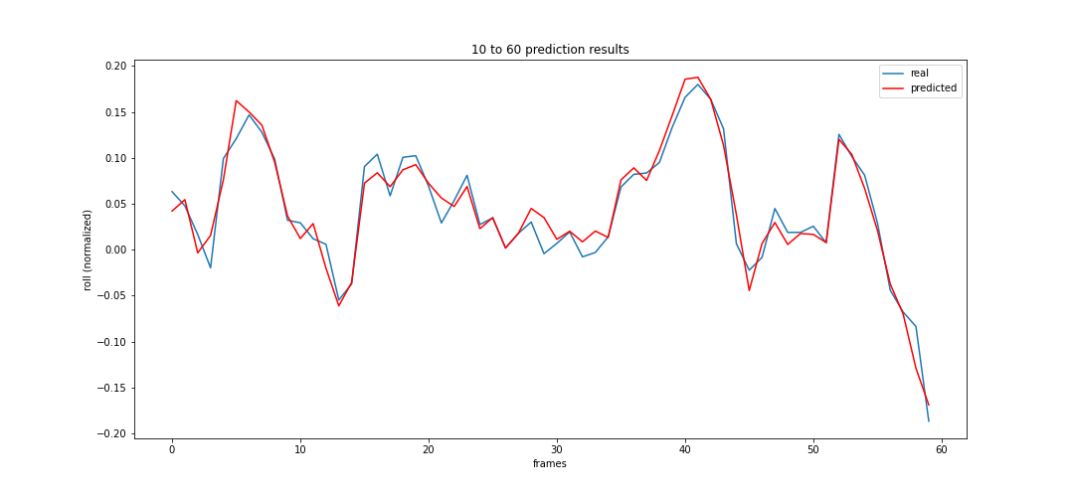
Prediction results
10/60 pitch (top)
10/60 roll (bottom)

Slide 16
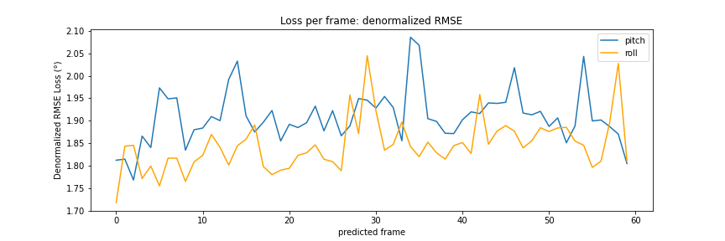
Loss per frame
10/60 RMSE
LPF < 2,1°

Slide 17
CNN LSTM pitch
Pitch prediction
MSE: 0.00028
RMSE: 0.0168
RMSE denorm: 1.51°
Zero prediction
MSE 0: 0.00518
RMSE 0: 0.072
RMSE denorm: 6.48°
Improvement on zero prediction:
MSE delta%: 1850.0 %
RMSE delta%: 428.57 %

Slide 18
CNN LSTM roll
Roll prediction
MSE: 0.00026
RMSE: 0.0162
RMSE denorm: 1.46°
Zero prediction
MSE 0: 0.00616
RMSE 0: 0.0785
RMSE denorm: 7.06°
Improvement on zero prediction:
MSE delta%: 2369.23 %
RMSE delta%: 484.57 %

Slide 19
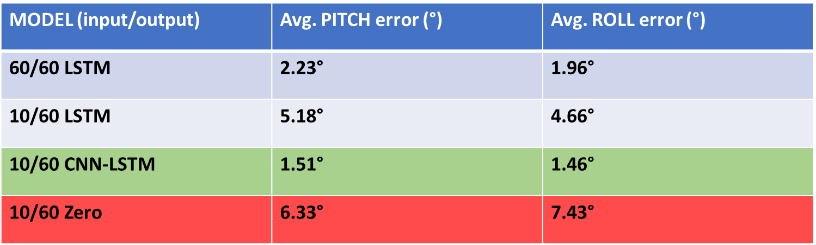
Results

Slide 20
To Do
Inference time comparison
Double check calculations
Add PR to input
New datasets: real and simulated

